Slide 1
By: Mahipal Singh National Geospatial Data Centre, Survey of India .
Creation of DEM using Contours and Height points

Slide 2
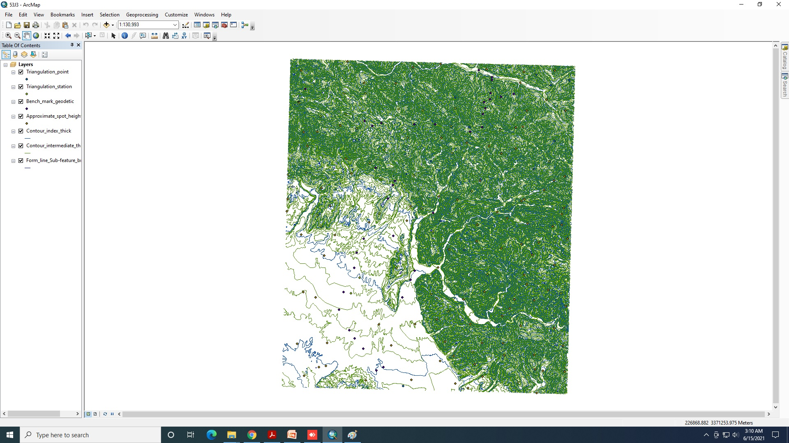
Software Used Arc GIS
Open Arc Map
Add contours and Height Points

Slide 3
It should be ensured that all the features are having Elevation
Open Arc Tools –3D Analyst Tools - Go to Data management- TIN

Slide 4
Click TIN – Go to Create Tin

Slide 5
Create TIN Dialog box will open Fill the dialog box as shown below

Slide 6
Click OK – TIN will be created as below

Slide 7
Now Go Arc Tool Box- 3D Analyst Tools- Conversion-Click on From TIN-Tin to Raster

Slide 8
Click OK – DEM will be created as below

Slide 9
It can be viewed in 3d Using ArcScene Module- Open Arc Scene and Add DEM just created

Slide 10
Now Right Click on DEM in layer window and select Properties

Slide 11
Properties Dialog Box will open Select the DEM as below

Slide 12
Click OK and it will be displayed as per DEM

Slide 13
Using Navigate window different views can be obtained

Slide 14
New View

